Slide 1


Slide 2
Finnish Food Culture
Preaparation for the Finnish Streaming Day

Slide 3
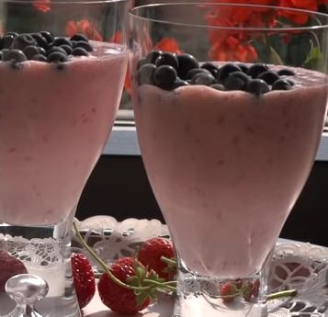
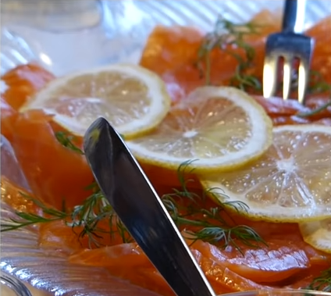

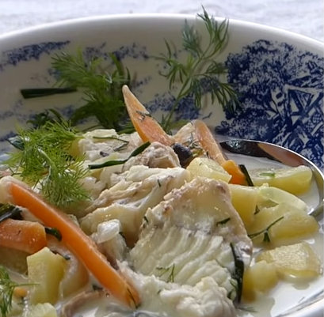
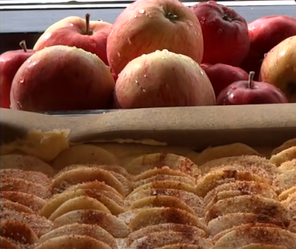
Finnish Food Culture - Assignement
Watch the videos about the Finnish food culture.
Answer to the questions after each video

Slide 4
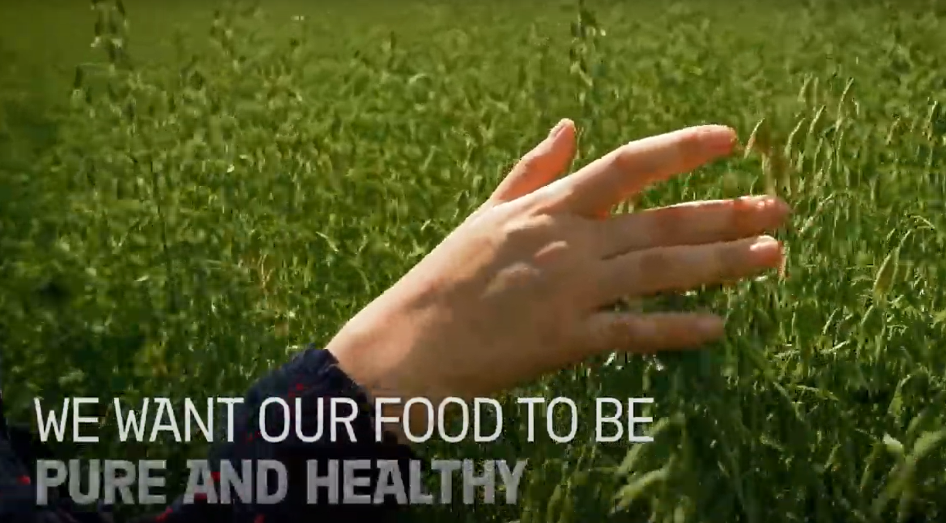
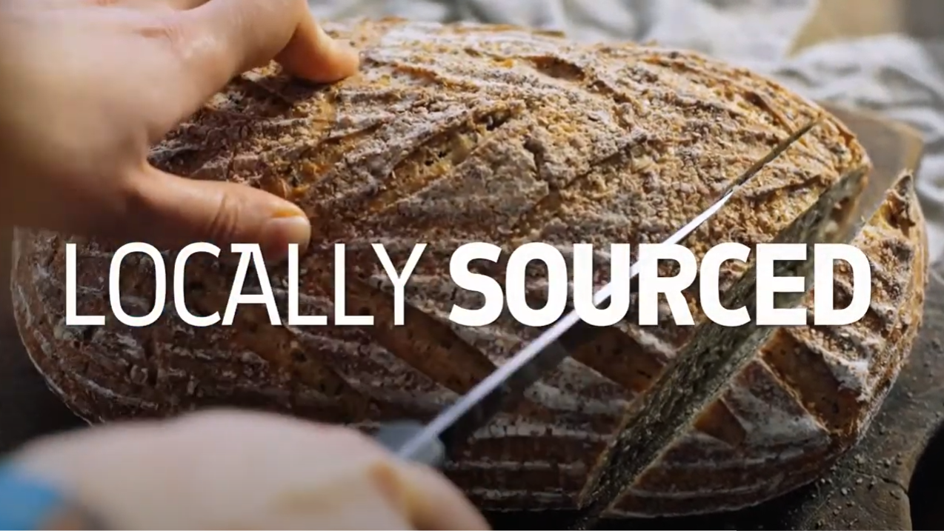
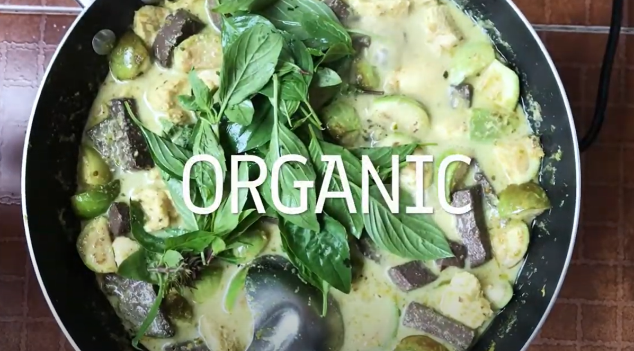
THE PUREST FOOD COMES FROM FINLAND
Finland is known for thousands of lakes, green forests,
northern lights, and the midnight sun. Being the greenest
country in the world, it is only natural that Finland is also
home to naturally delicious, pure, safe and healthy food.

Slide 5
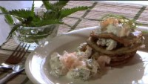
“What Do they eat, Finnish food, naturally” – video (26 min)

Slide 6
“What Do they eat, Finnish food, naturally” - video
Questions to be answered:
What bread Finns miss when they are abroad?
What do most of the Finns prefer to drink when they eat?
Did you notice some imported food? What?
What means “Every man’s right”?
Link to the video

Slide 7

“Top 10 Foods from Finland You Need to Try” – video (4 min)

Slide 8
“Top 10 Foods from Finland You Need to Try” - video
Questions to be answered:
What was the most interesting food? Why?
What Finnish food would you like to try?
Link to the video

Slide 9

The Purest Food Comes from Finland: “World ideas on Food” – video (2 min)

Slide 10
“World ideas on Food” – video
Questions to be answered:
Which berry is Finnish super food?
What are the reasons for the pureness of Finnish food? (You can check also the additional information)
Link to the video
Additional information:
https://www.businessfinland.fi/en/do-business-with-finland/explore-key-industries/food-and-beverages

