Slide 1


Slide 2
La France et la riviera française
France and the French Riviera

Slide 3
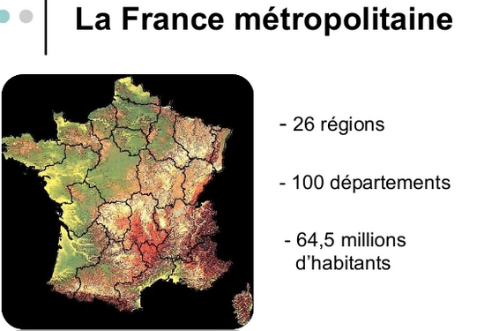
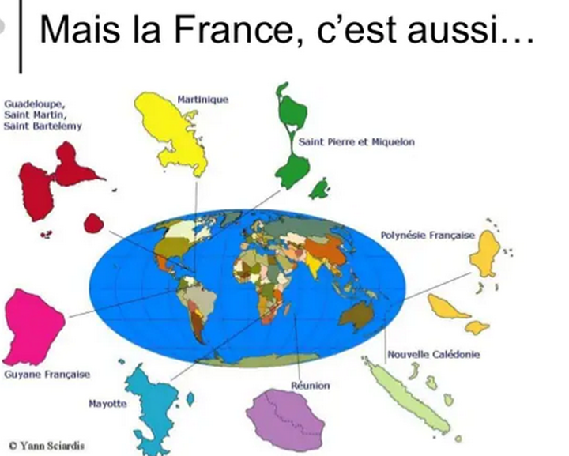
La France en quelques chiffres…
Some data about France…

Slide 4
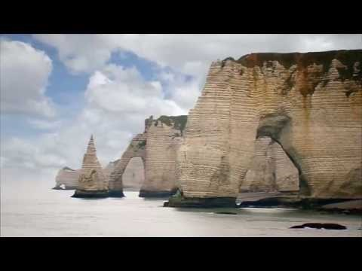
La France en vidéo A video about France
Double clic image

Slide 5
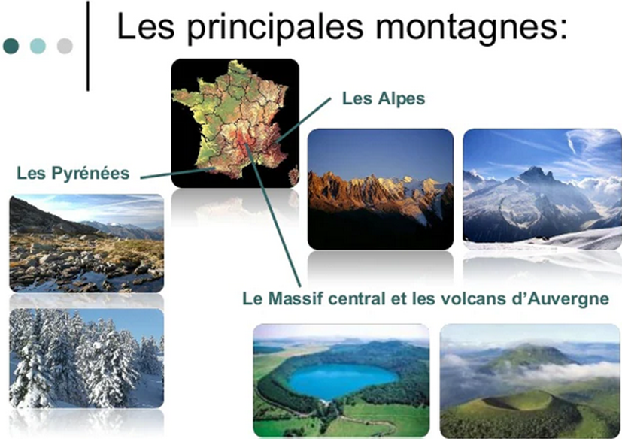
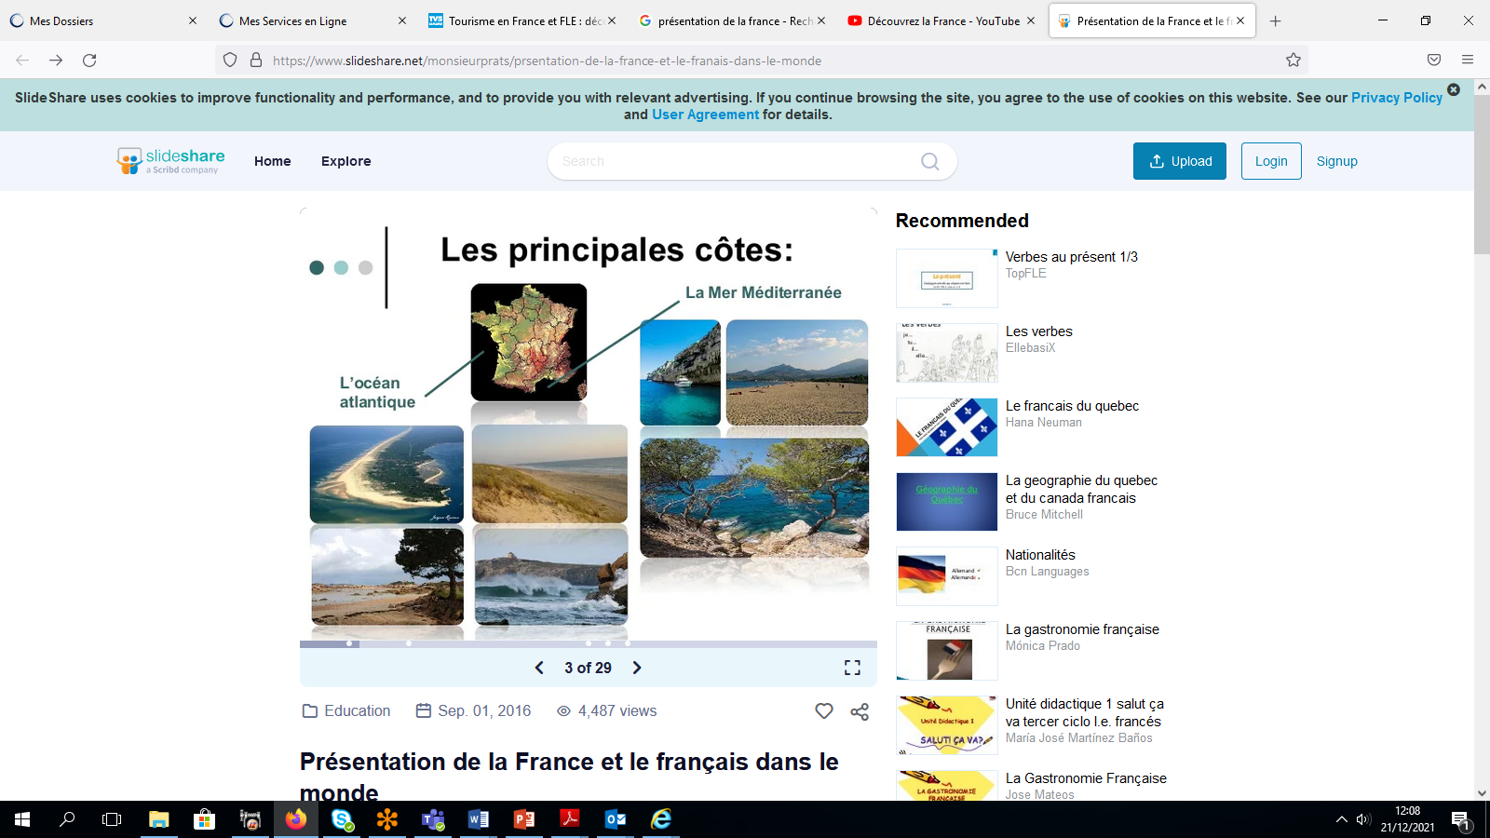
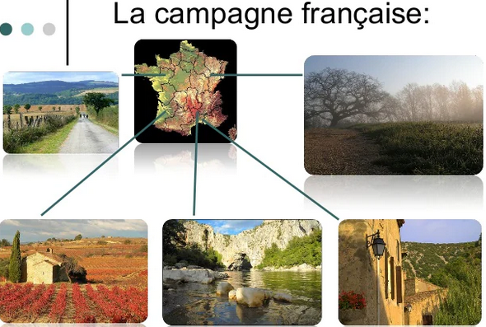
La diversité Française…
The French diversity of mountains, coasts, landscape, countryside…

Slide 6
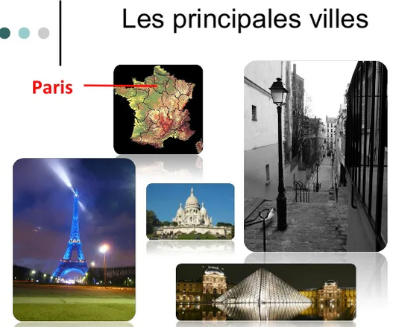
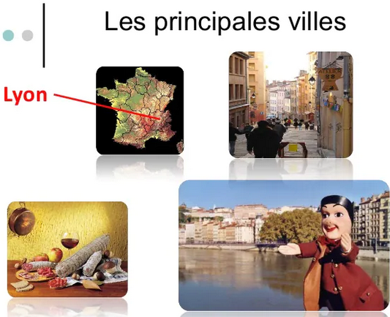
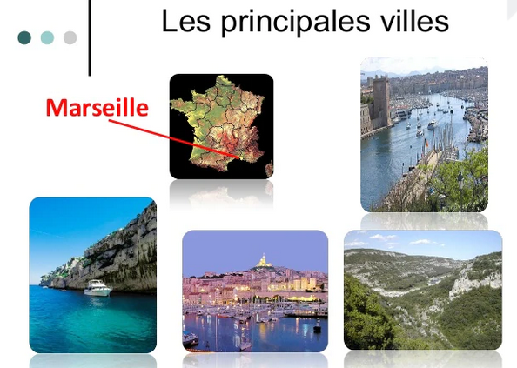
The largest
French cities

Slide 7
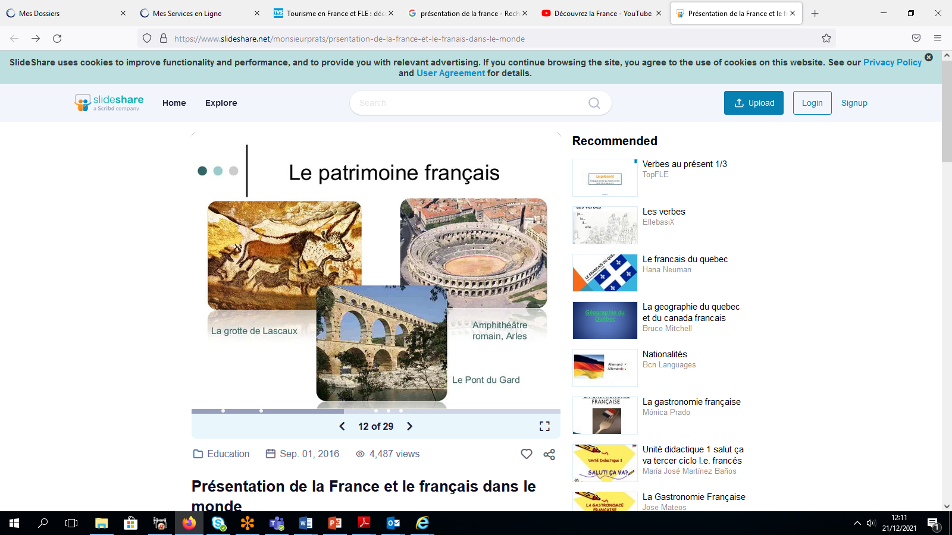
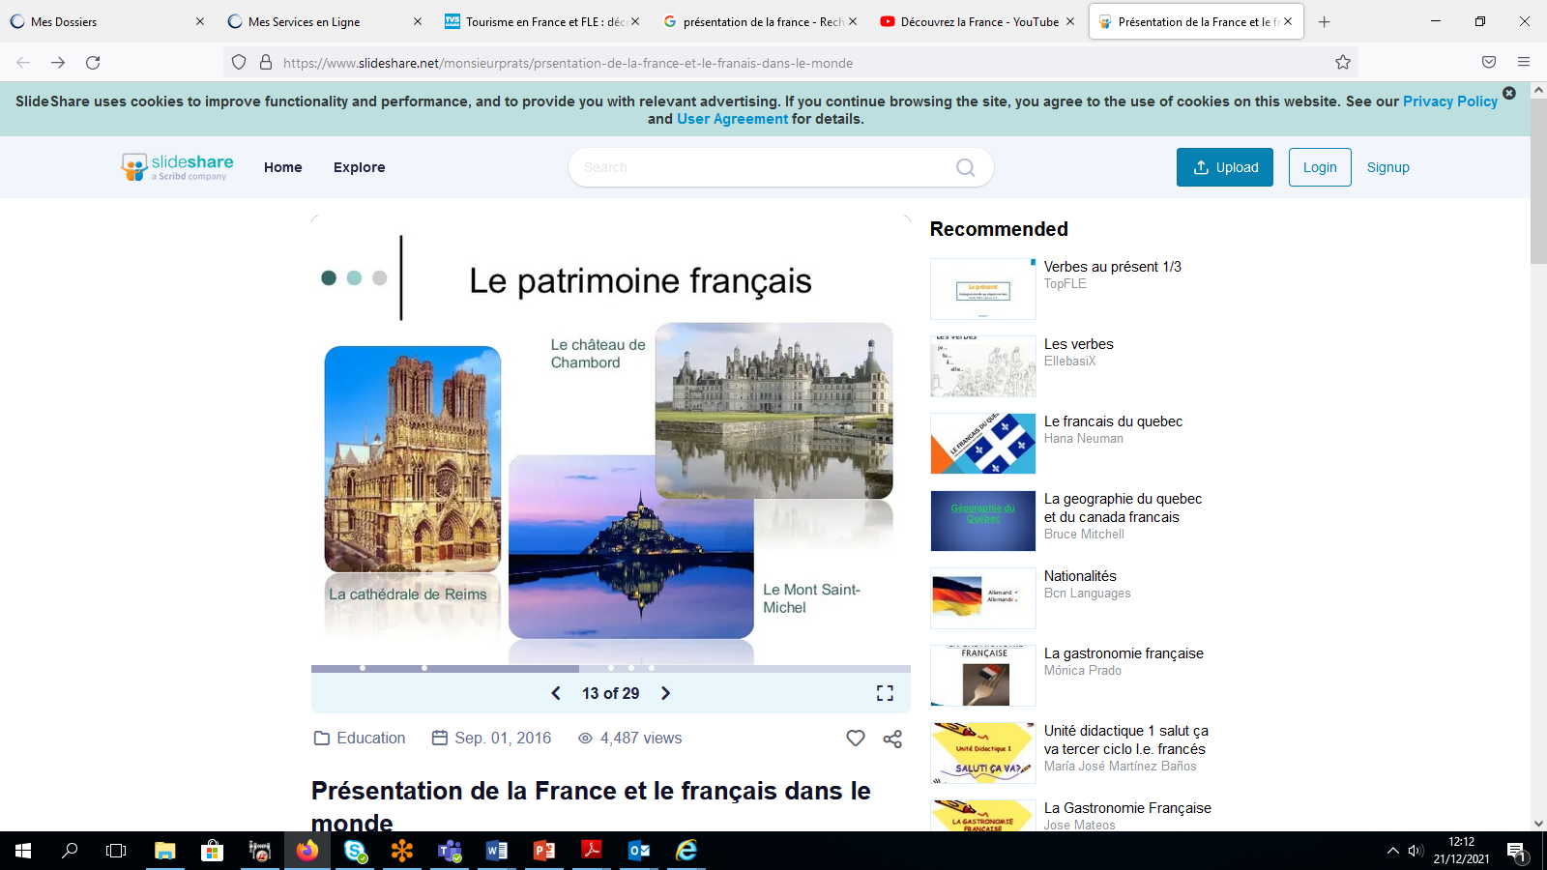
Un patrimoine polyforme A multiform history heritage

Slide 8
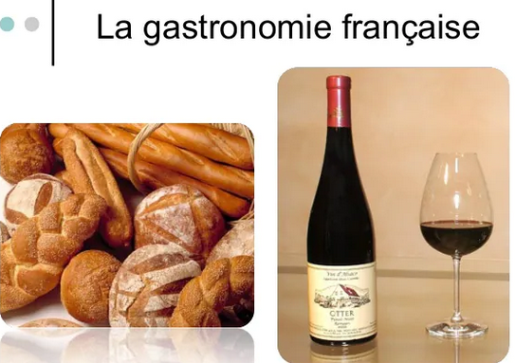
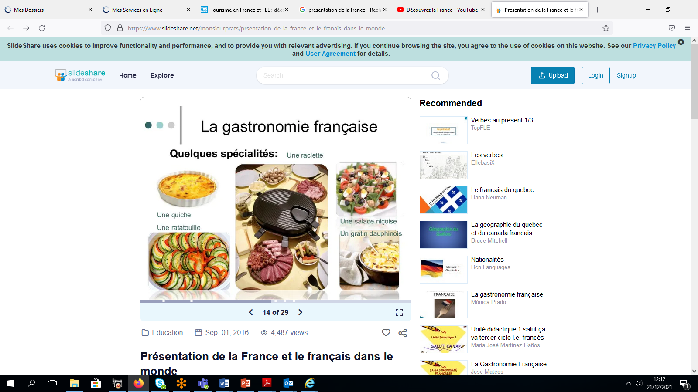
Une culture alimentaire Food culture

Slide 9
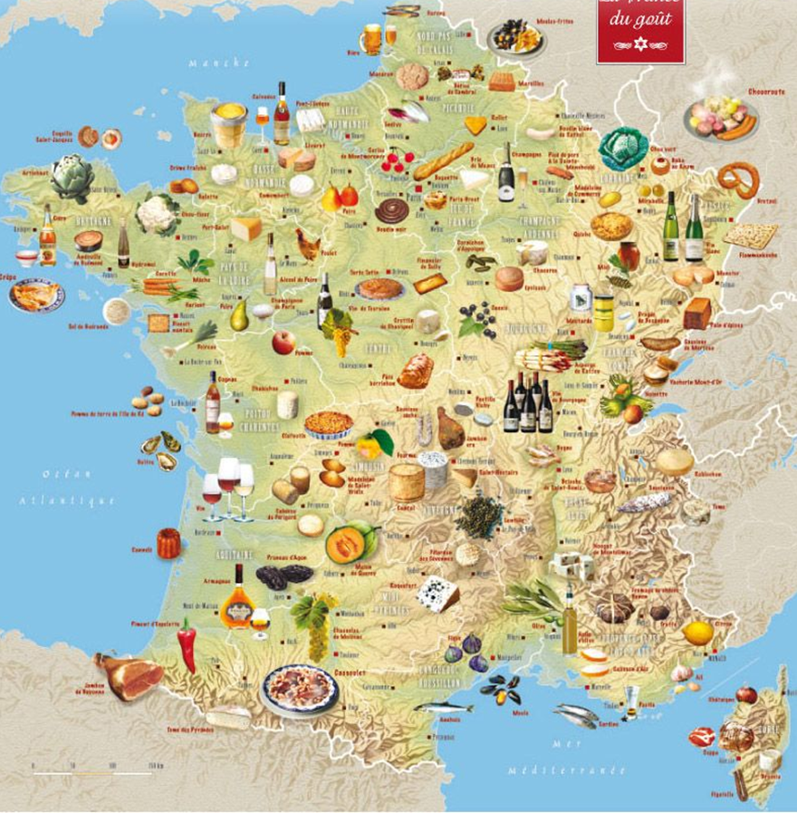
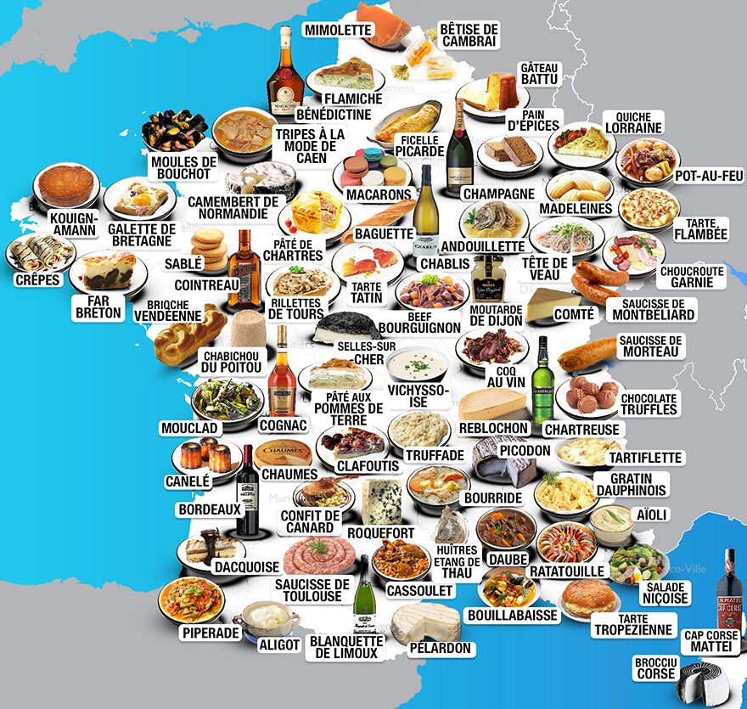
Une culture alimentaire et vins Food culture and wine

Slide 10
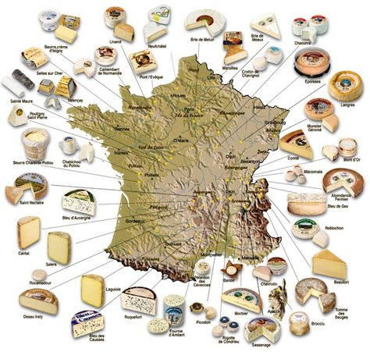
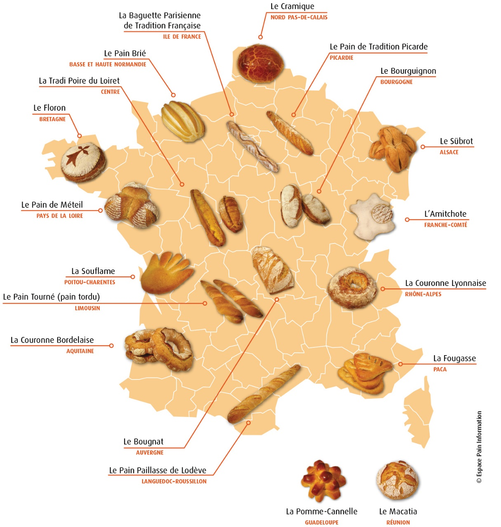
Pain Bread
Fromage Cheese

Slide 11

La French riviera
Double clic image

Slide 12

Cannes Our city
Double clic image

Slide 13
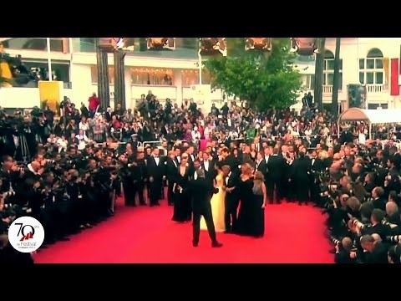
Cannes x son festival
Cannes and the international film event
Double clic image

Slide 14

Notre établissement Our school

Slide 15
Have you got some questions?
We are really happy that we'll be working together in
the Module it project!

