Slide 1


Slide 2
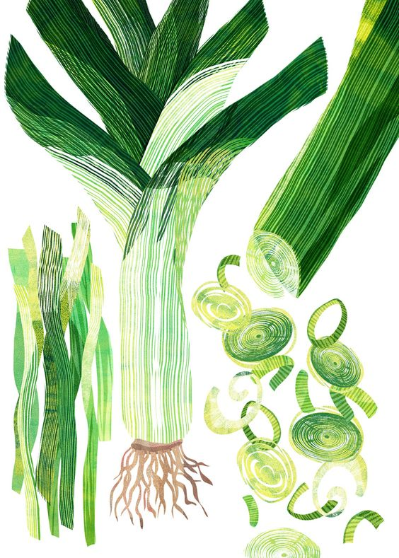
ITALIAN GASTRONOMY
HERITAGE
(of imagination, ingenuity, sensitivity, art, craftmanship, science)
connected to the
TERRITORY
MUNICIPAL AND RURAL
DIFFERENT CLIMATE CONDITIONS
DIFFERENT AGRICULTURE PRACTICES
DIFFERENT HYSTORICAL AND CULTURAL HERITAGE

Slide 3
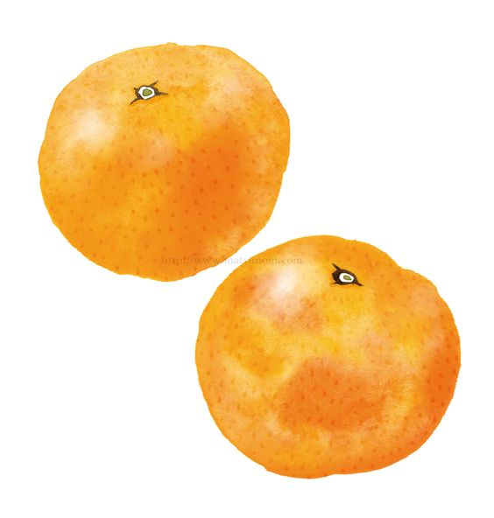
PRODUCTION
Italian food and wine products depend from:
Different regional traditions on food system
Differentiated production combined with local products
Link to the video: Products and territories of Italian cuisine: https://www.youtube.com/watch?v=y0I0h9etEX0

Slide 4
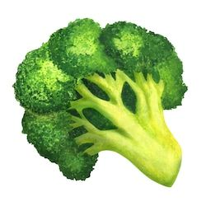
ROOTS OF CULINARY CULTURE
Knowing the history of traditional italian cuisine its a fundamental step in the training of a professional chef
The history of Italian cuisine has been influenced by all the peoples who, over the centuries, have left their mark.
Romans, Greeks and Arabs are just some of the peoples who have contributed to creating a culinary tradition that has lasted for centuries.

Slide 5
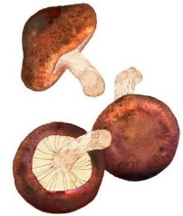
EATING WELL
The dishes that have made the history of Italian cuisine are poor, simple dishes, prepared with very few ingredients. On the other hand, there are many traditional Italian recipes, as well as regional variations.

Slide 6

Many foods are now part of our culinary heritage, but with American origins: potatoes, corn, tomatoes are just a few examples of products that do not originate in our territory but are now indispensable for us.

Slide 7
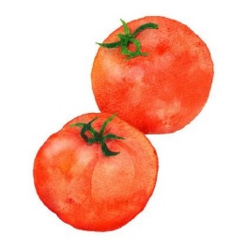
GASTONOMIC UNIFICATION
The gastronomic unification of our country took place after the Second World War, thanks to internal migrations and a more efficient transport system which promoted and accelerated the circulation of people, products and ideas between North and South

Slide 8
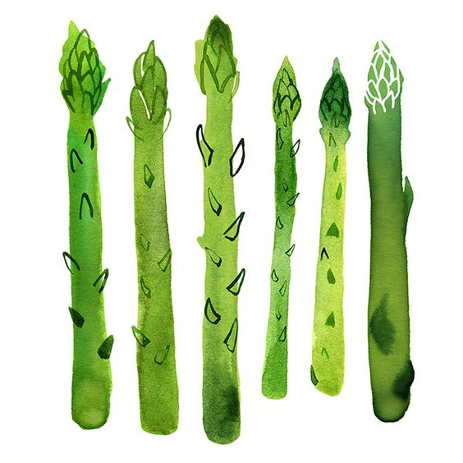
Even in more recent times, the mixing of distant worlds has enriched the Italian table with new ingredients, thanks to the penetration of so-called ethnic gastronomic cultures, which have inspired new dishes defined as fusion.

Slide 9
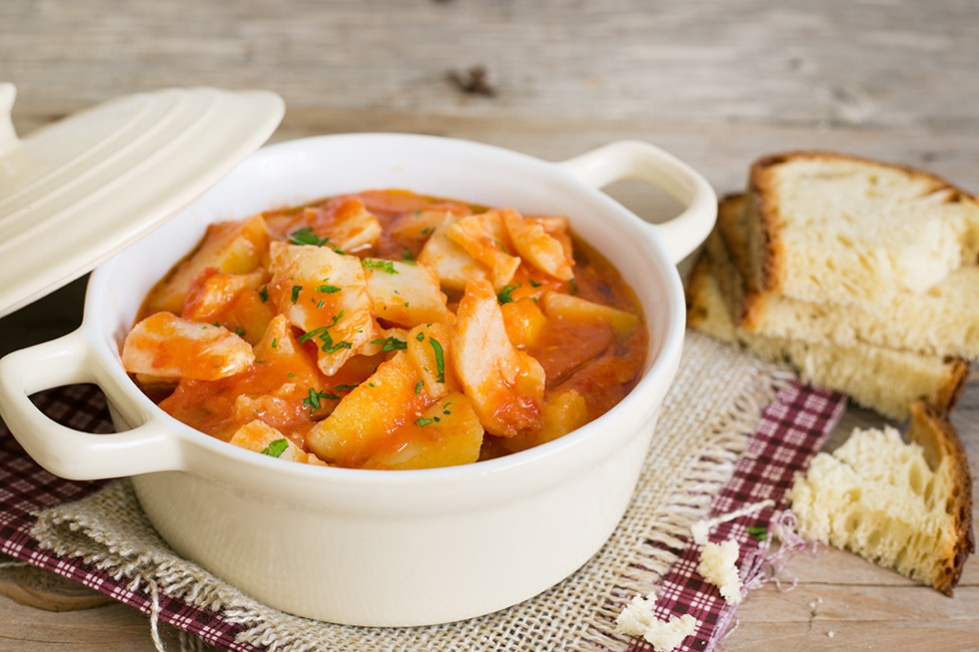
There are dishes that are so interwoven in our cuisine that they seem to have always been rooted in the territory, even though they are in fact foreign to the original gastronomic culture. This is the case, for example, of STOCKFISH with POTATOES: the dried cod came from the northern seas of Europe, while the potatoes came from the Americas.

Slide 10
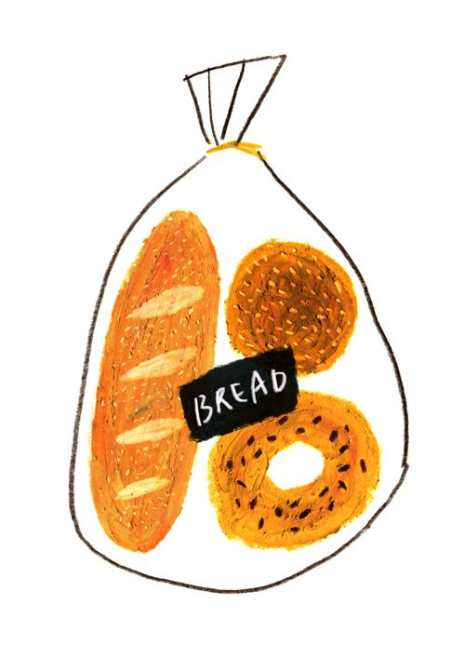
The evolution of Italian gastronomy, therefore, cannot disregard the contaminations that have enriched and developed it in every historical period. However, it should be remembered that even at the beginning of the 1960s, it had all the characteristics of the cuisine of poor countries.

Slide 11
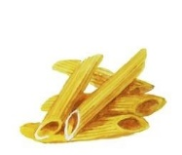
People sat at the table to satiate themselves, rather than to enjoy the goodness and refinement of the food. The first course - often the only course - was a carbohydrate-based preparation, so energetic, cheap and suitable for staving off hunger.
By contrast, in neighbouring France, carbohydrates served as a garnish for protein dishes, mainly meat or fish, i.e. more expensive and valuable foods

Slide 12
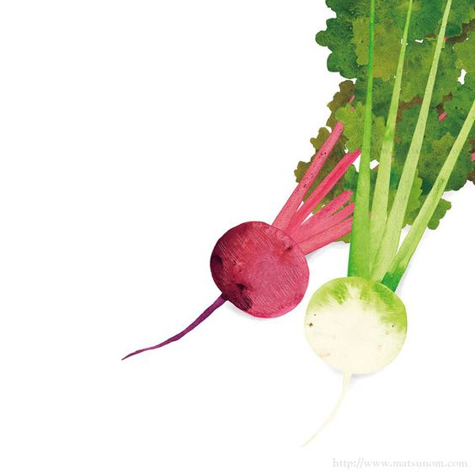
When the economic boom came to the country, the quantity rather than the quality of food on the Italian table increased.
In those years of economic prosperity, whether at home or in a restaurant, a dish was valued primarily for its generous portion size: the palate, not yet as refined as today's, was much less demanding in terms of quality.

Slide 13
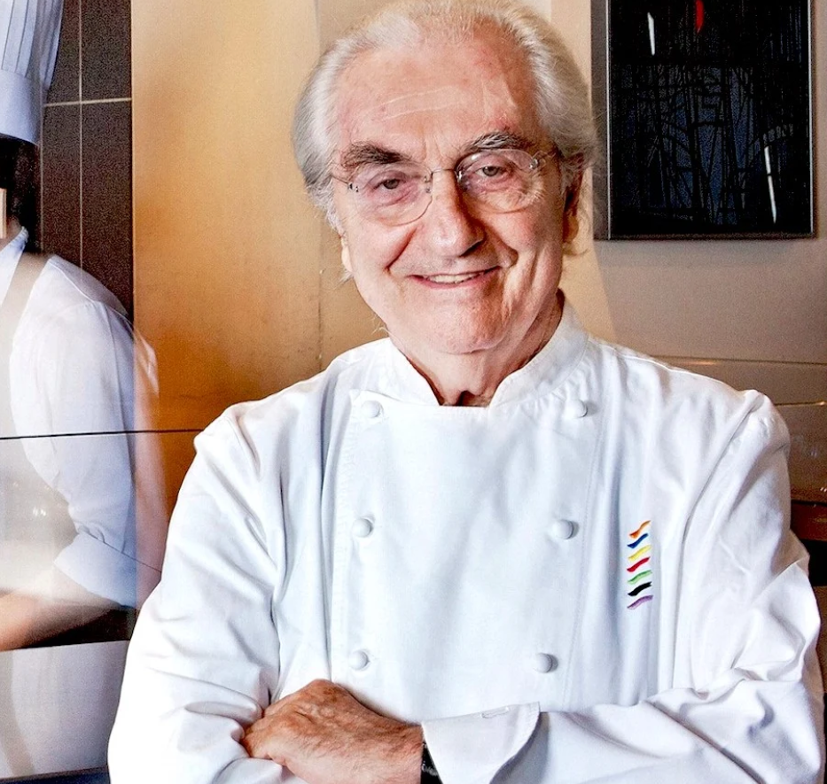
In that very decade, a revolution exploded that marked a radical change in Italian cuisine, and there was no way back. It was sparked by Gualtiero Marchesi, a chef with culinary techniques and international experience. Marchesi reformulated Italian cuisine.

Slide 14
MARCHESI REFORMULATED ITALIAN CUISINE
REDUCED FAT and REDUNDAND INGREDIENTS
REDUCED THE EXHAUSTING COOKING TIMES
AIMING FOR THE ORIGINAL FLOUR OF THE FOOD

Slide 15
MAIN MEALS
BREAKFAST
LUNCH
DINNER

Slide 16
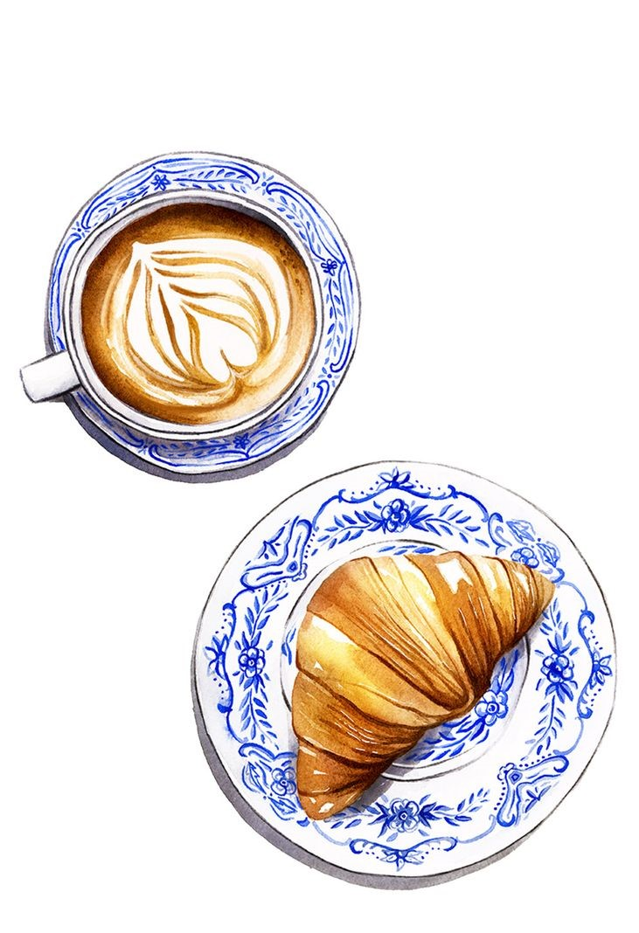
BREAKFAST
The most popular breakfast in Italy is sweet, eaten at home or at the bar.
Cappuccino is a classic Italian breakfast drink

Slide 17
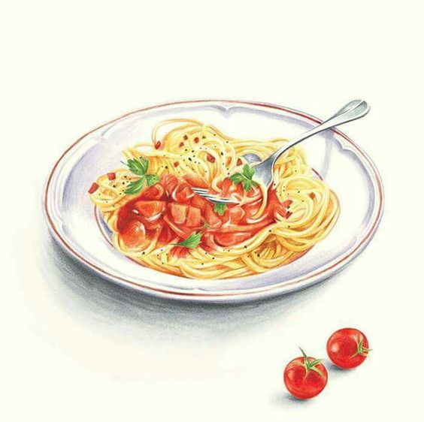
LUNCH
In Italian culture, lunch is often considered the most important meal of the day.
Spaghetti all'arrabbiata is a classic example of a pasta dish in an Italian lunch.

Slide 18
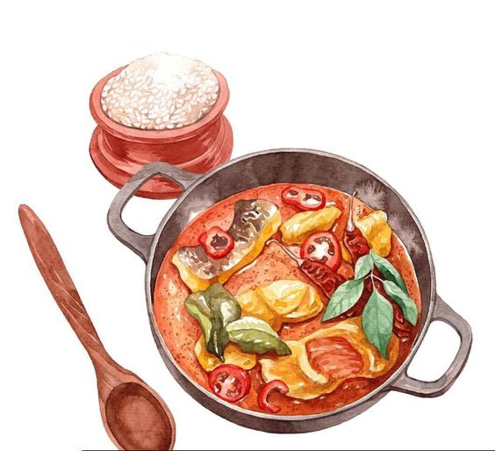
DINNER
Together with lunch, it is the other main meal of the day.
Stewed salt cod with cruschi peppers, an example of a second course.

Slide 19

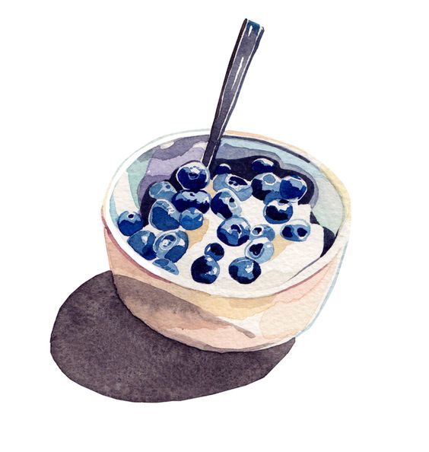
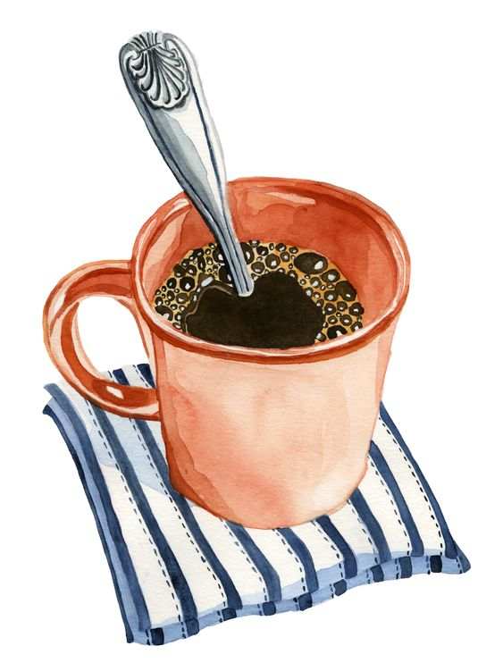

MID-MORNING and MID-AFTERNOON SNACK

