Slide 1


Slide 2
Welcome to
Module it class!
11/01/2023

Slide 3
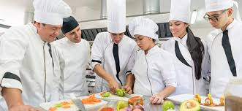
What is Module it?
It is an European project that involves students and teachers from
ITALY, FRANCE, THE NETHERLANDS AND FINLAND
in particular from the cooking sector
We are going to have common cooking classes, sharing knowledge and cooking traditions

Slide 4


We are here
Seinajoki, Finland
Groningen, The Netherlands
Alba, Italy
Cannes, France

Slide 5
The programme of Module it
40 hours in total
Preparatory activities
Streaming cooking classes
Project work
Final evaluation

Slide 6
Preparatory activities: 11 hours
Kick-off meeting: today!
Classes on cooking traditions of Italy, France, Netherlands and Finland
Classes on 4 recipes we are doing together in streaming classes
Maths classes: cost and selling price of recipes
Science classes: nutrition and sustainability analisys of recipes

Slide 7
Streaming of cooking classes
Wednesday 01 February - Finnish recipe
Wednesday 22 February – Dutch recipe ​
Wednesday 15 March – Italian recipe
Wednesday 29 March – French recipe
Sugar-salted salmon FI
Croquette NL
Agnolotti
IT
Paris-Brest
FR

Slide 8
Project work: plan a thematic menu
You will be divided in groups with students from other countries
TASK: Planning a thematic menu on a certain topic
ACTIVITIES:
Brainstorm with your classmate and propose some recipes typical of your Country
Then online with international peers agree to a common menu made up of 4 recipes (from starter to dessert)
Put the menu together in a template
Pitch the thematic menu in your class

Slide 9
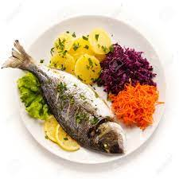

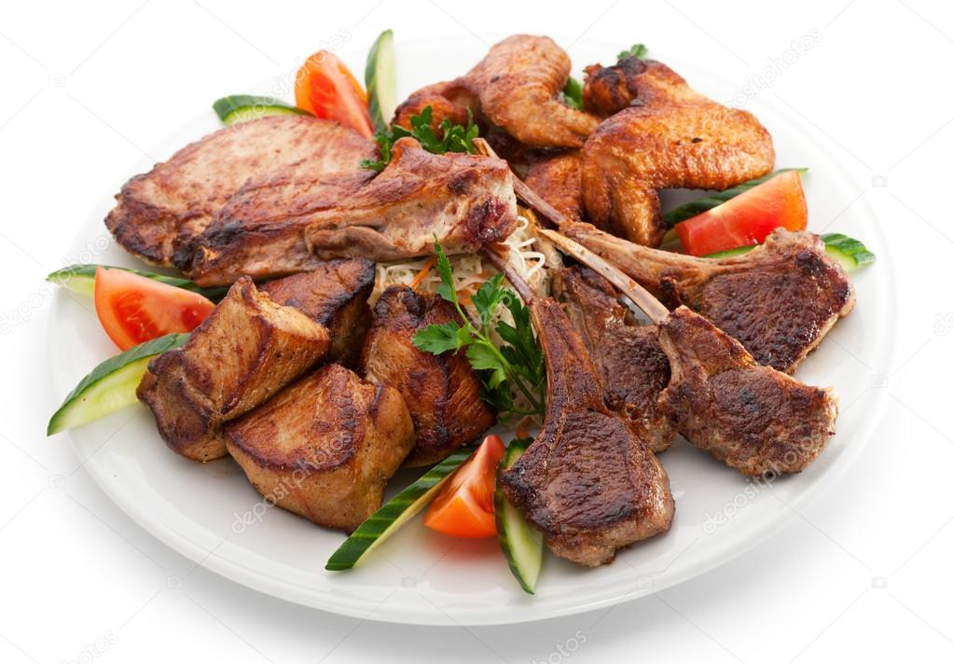
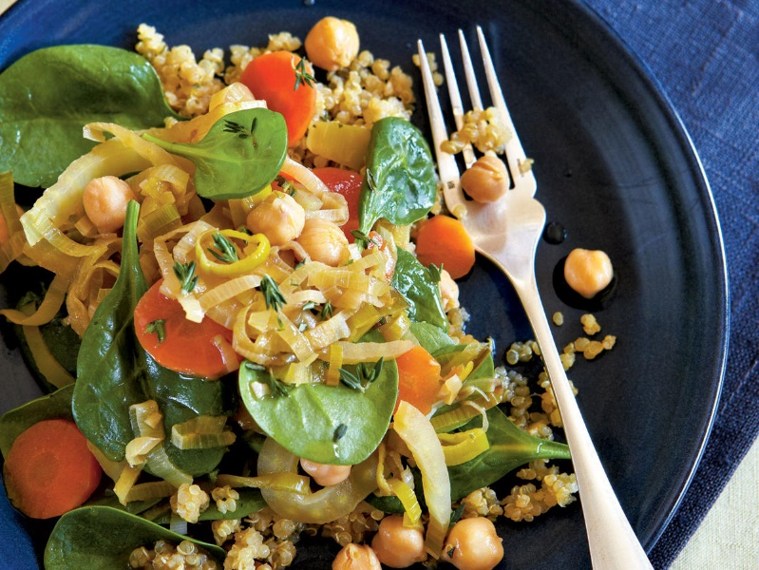
Project work: topics
Fish
Vegetarian
BBQ/meat
Gluten-free

Slide 10
Group 1: Fish menu
Moderator:
prof. xxx
Name | Surname | School

Slide 11
Group 2: Vegetarian menu
Moderator:
prof. xxx
Name | Surname | School

Slide 12
Group 3: BBQ/meat menu
Moderator:
prof. xxx
Name | Surname | School

Slide 13
Group 4: gluten-free menu
Moderator:
prof. xxx
Name | Surname | School

Slide 14
Final assessment will be made on these aspects:
Project work
A multiple choice test
Cooking ability
Team work
Satisfaction evaluation on Module it

Slide 15


Cooperation environment
We will cooperate online through Microsoft Teams
Streaming classes will be made directly in our cooking laboratories (kitchen) and broadcasted through Youtube

Slide 16
Thanks for your attention and see you online!

