Slide 1


Slide 2
Project work assignment

Slide 3
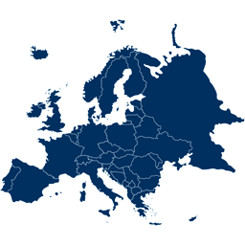

We are here
Seinajoki, Finland (SEDU)
Groningen, The Netherlands (NOORDERPOORT)
Alba, Italy (APRO)
Cannes, France (FDM)

Slide 4


The programme of Module it
40 hours in total
Preparatory activities
Streaming cooking classes
Project work
Final evaluation
Now we are here

Slide 5
Project work: plan a thematic menu
You are divided in 4 groups with students from other countries
TASK: You have to plan a thematic menu on a certain topic
4 GROUPS = 4 THEMATIC MENUS
1. FISH MENU
2. VEGETARIAN MENU
3. BBQ/MEAT MENU
4. GLUTEN FREE MENU

Slide 6
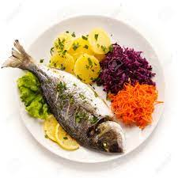
Group 1: Fish menu
Moderator:
prof. xxx
Name | Surname | School

Slide 7
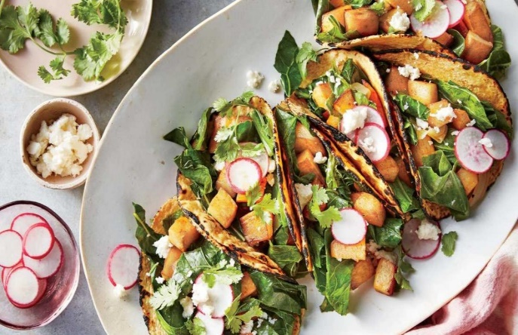
Group 2: Vegetarian menu
Moderator:
prof. xxx
Name | Surname | School

Slide 8
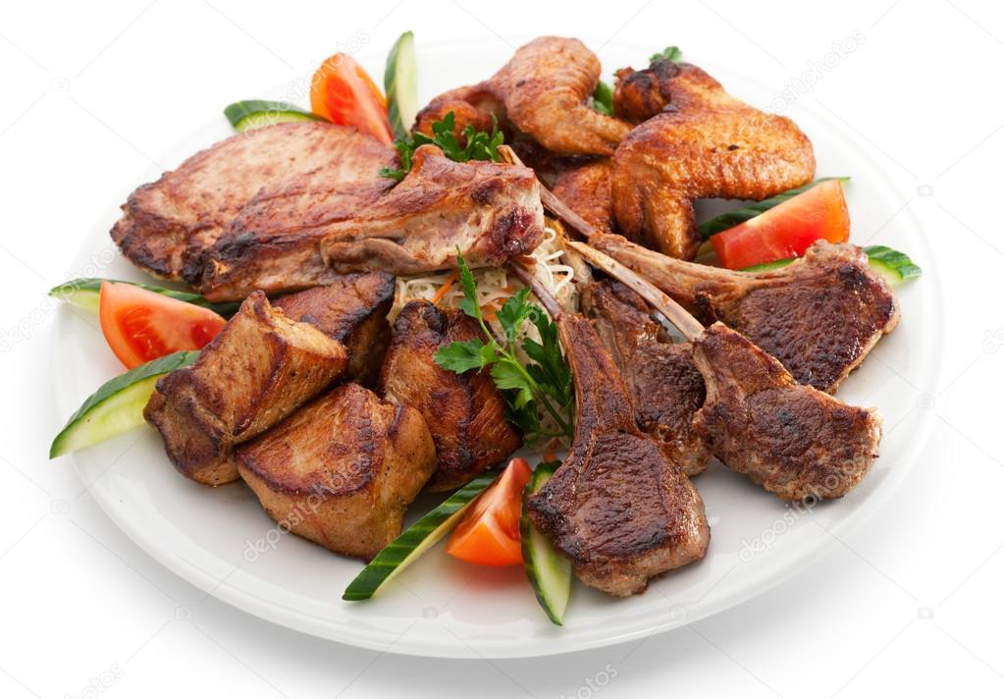
Group 3: BBQ/meat menu
Moderator:
prof. xxx
Name | Surname | School

Slide 9
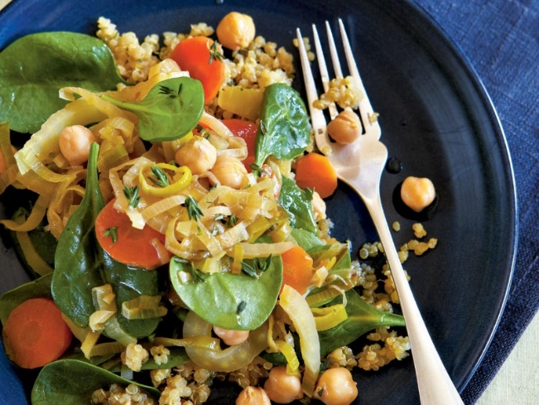
Group 4: gluten-free menu
Moderator:
prof. xxx
Name | Surname | School

Slide 10
Project work: plan a thematic menu
ACTIVITIES:
Brainstorm with your classmate and propose some recipes typical of your Country and related to your assigned menu
Then online with international peers agree to a common menu made up of 4 recipes (a starter, a first course, a second course, a dessert)
Put the menu together in a template
Pitch the thematic menu in your class

Slide 11
Project work: plan a thematic menu
ONLINE MEETING:
It will be held online on Microsoft Teams,
March 29/03 from 13.30 to 16.30 CEST (14.30 – 17.30 Finnish time)

Slide 12
Thanks for your attention and see you online!

